Slide 1
影像處理、電腦視覺及深度學習概論 (Introduction to Image Processing, Computer Vision and Deep Learning) Homework 1
TA:
彥博: nckubot65904@gmail.com
Office Hour: 17:00~19:00, Mon.
10:00~12:00, Fri.
At CSIE 9F Robotics Lab.

Slide 2
Notice (1/2)
Copying homework is strictly prohibited!! Penalty: Grade will be zero for both persons!!
If the code can’t run, you can come to our Lab within one week and show that your programming can work. Otherwise, you will get zero!!
Due date =>23:59:59, 2021/11/28 (Sun.)
No delay. If you submit homework after deadline, you will get 0.
Upload to => 140.116.154.1 -> Upload/Homework/Hw1
User ID: opencvdl2021 Password: opencvdl2021
Format
Filename: Hw1_StudentID_Name_Version.rar
Ex: Hw1_F71234567_林小明_V1.rar
If you want to update your file, you should update your version to be V2, ex: Hw1_F71234567_林小明_V2.rar
Content: project folder*( including the pictures ) *note: remove your “Debug” folder to reduce file size

Slide 3
Notice (2/2)
Python (recommended)
Python 3.7 (https://www.python.org/downloads/)
opencv-contrib-python (3.4.2.17)
Matplotlib 3.1.1
UI framework: pyqt5 (5.15.1)
C++ (check MFC guide in ftp)
OpenCV 3.3.1 (https://opencv.org/release.html)
Visual Studio 2015 (download from http://www.cc.ncku.edu.tw/download/)
UI framework: MFC

Slide 4
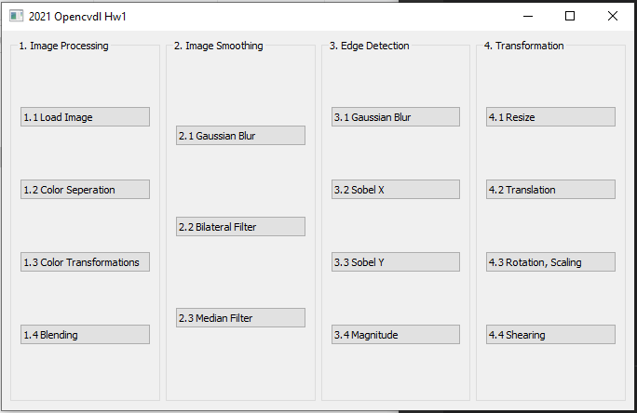
Assignment scoring (Total: 100%)
1. (20%) Image Processing
1.1 (5%) Load Image File
1.2 (5%) Color Separation
1.3 (5%) Color Transformation
1.4 (5%) Blending
2. (20%) Image Smoothing
2.1 (5%) Gaussian blur
2.2 (5%) Bilateral filter
2.3 (10%) Median filter
3. (20%) Edge Detection
3.1 (5%) Gaussian Blur
3.2 (5%) Sobel X
3.3 (5%) Sobel Y
3.4 (5%) Magnitude
4. (20%) Transforms:
4.1 (5%) Resize
4.2 (5%) Translation
4.3 (5%) Rotation, Scaling
4.4 (5%) Shearing
5. (20%) Training Cifar-10 Classifier Using VGG16
(出題：Tina)
(出題：Willy)
(出題：Lydia)
(出題：Ray)
(出題：Tommy)

Slide 5
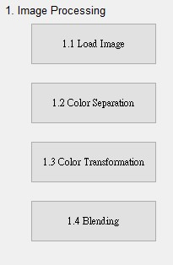
1. Image Processing (20%)
(出題: Tina)
1.1 Load Image File (5%)
1.2 Color Separation (5%)
1.3 Color Transformation (5%)
1.4 Blending(5%)

Slide 6
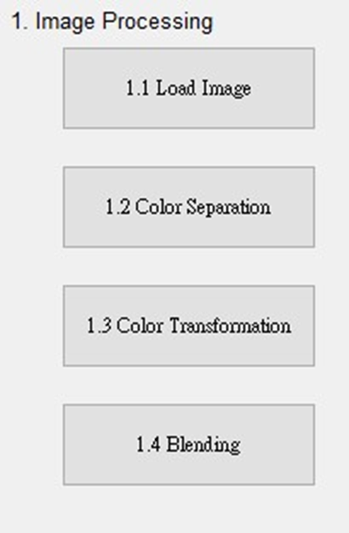
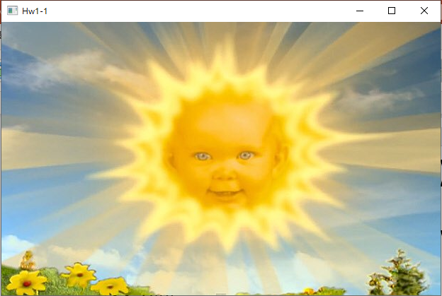
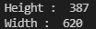
1.1 Load Image File (5%)
(出題：Tina)
Given: “Sun.jpg” image
Q: 1) Open a new window to show the image (Sun.jpg)
2) Show the height and width of the image in console mode
Hint :
Textbook Chapter 2, p. 22~23
cv2.imread(), cv2.imshow()

Slide 7
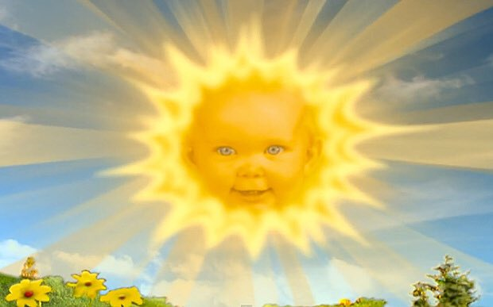
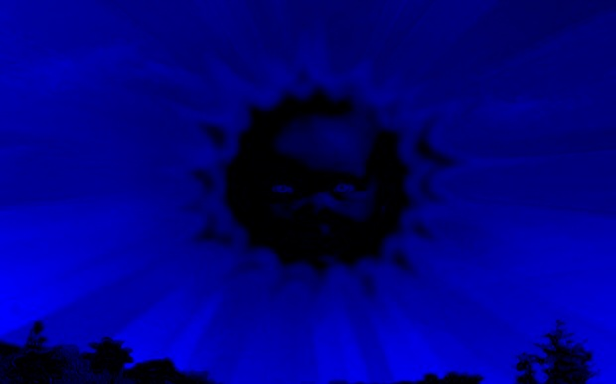
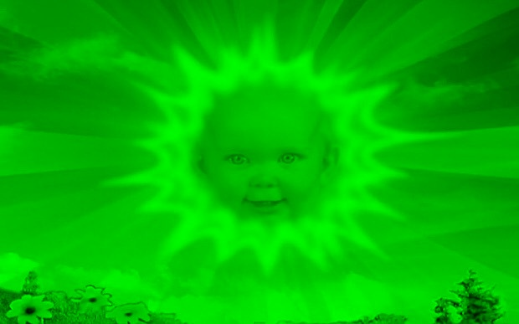
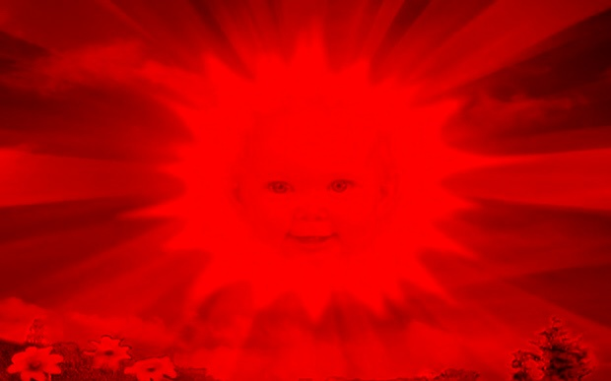
1.2 Color Separation (5%)
(出題：Tina)
Given: a color image, “Sun.jpg”
Q: 1) Extract 3 channels of the image BGR to 3 separated channels and show the result images.
Hint:
Textbook Chapter 3, p.31 ~ p.49
cv2.split(), cv2.merge()
Sun.jpg
B channel
G channel
R channel

Slide 8
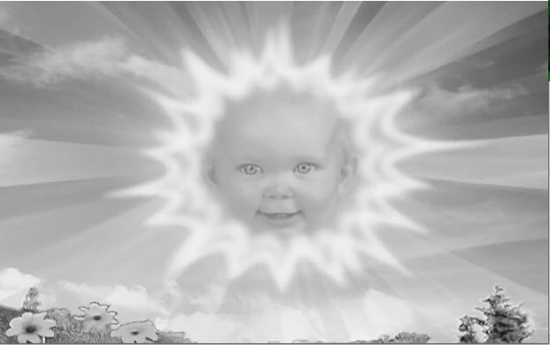
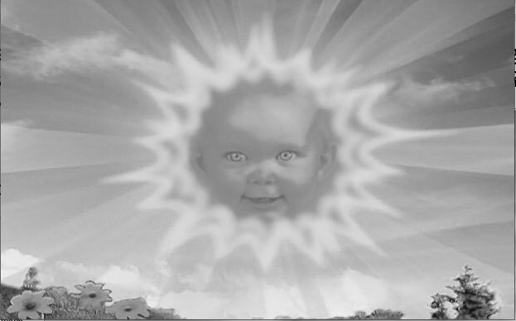
1.3 Color Transformation (5%)
(出題：Tina)
Given: 1 color image: “Sun.jpg”
Q: 1) Transform “Sun.jpg” into grayscale image I₁ by calling OpenCV function directly.
2) Merge BGR separated channel images from problem 1.2 into grayscale image I₂ by I₂ = (R+G+B)/3.
3) Show the above 2 results.
Hint:
Textbook Chapter 3, p.56 ~ p.59
cv2.cvtColor(…, cv2.COLOR_BGR2GRAY)
Sun.jpg
B channel
G channel
R channel
1) OpenCV function
2) Average weighted
I₁
I₂
Perceptually weighted formula:
I₁ = 0.07*B + 0.72*G + 0.21*R
Average weighted formula:
I₂ = (R+G+B)/3

Slide 9
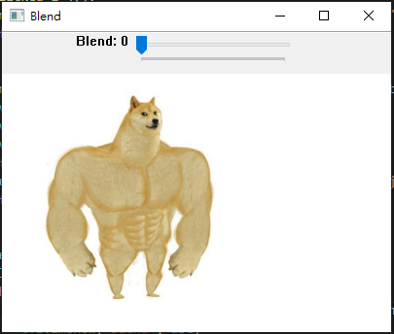
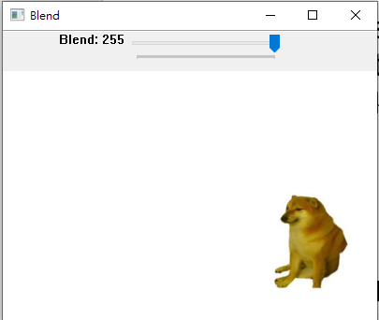
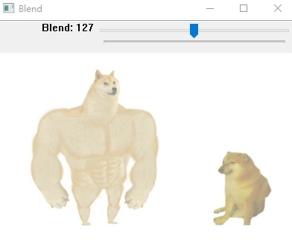
1.4 Blending (5%)
(出題：Tina)
Given: 2 images, “Dog_Strong.jpg” and “Dog_Weak.jpg”
Q: 1) Combine two images (Dog_Strong.jpg and Dog_Weak.jpg). 2) Use Trackbar to change the weights and show the result in the new window.
Hint:
Textbook Chapter 3, p. 50 ~ 52
cv2.addWeighted(), cv2.createTrackbar()
Demo:

Slide 10
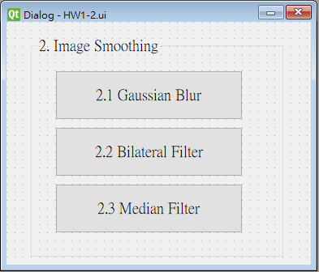
2. Image Smoothing (20%)
(出題: Willy)
2.1 Gaussian blur (5%)
2.2 Bilateral filter (5%)
2.3 Median filter (10%)

Slide 11
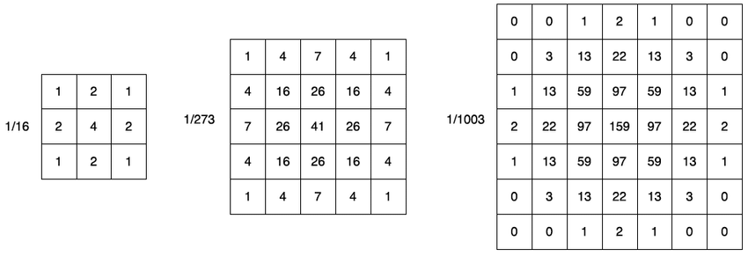


2.1 Gaussian Blur
(出題：Willy)
Given: a color image, “Lenna_whiteNoise.jpg”
Q: 1) Apply 5x5 Gaussian filter to “Lenna_whiteNoise.jpg”
Hint: Textbook Chapter 5, p.109 ~ p.115
Lenna_whiteNoise.jpg

Slide 12
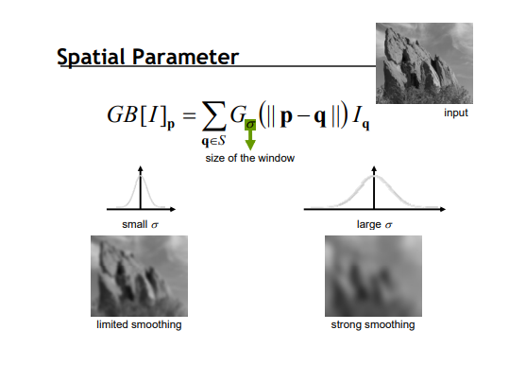

2.2 Bilateral Filter
(出題：Willy)
Given: a color image, “Lenna_whiteNoise.jpg”
Q: 1) Apply 9x9 Bilateral filter with 90 sigmaColor and 90 sigmaSpace to “Lenna_whiteNoise.jpg”
Hint: Textbook Chapter 5, p.109 ~ p.115
Lenna_whiteNoise.jpg

Slide 13
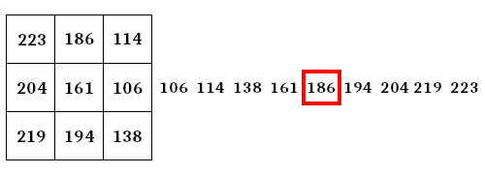
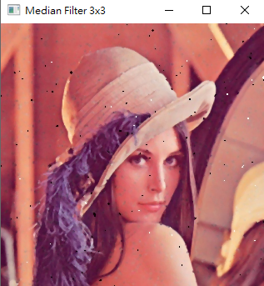

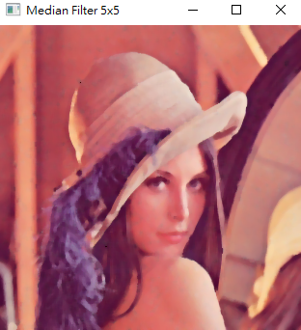
2.3 Median Filter
(出題：Willy)
Given: a color image, “Lenna_pepperSalt.jpg”
Q:
1) Apply 3x3 median filter to “Lenna_ pepperSalt.jpg”
2) Apply 5x5 median filter to “Lenna_ pepperSalt.jpg”
Hint: Textbook Chapter 5, p.109 ~ p.115
Median filter example
Lenna_pepperSalt.jpg
3x3
5x5

Slide 14
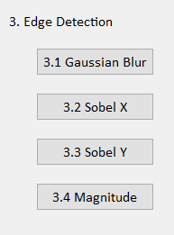
3. Edge Detection (20%)
(出題: Lydia)
3.1 Gaussian Blur (5%)
3.2 Sobel X (5%)
3.3 Sobel Y (5%)
3.4 Magnitude (5%)

Slide 15
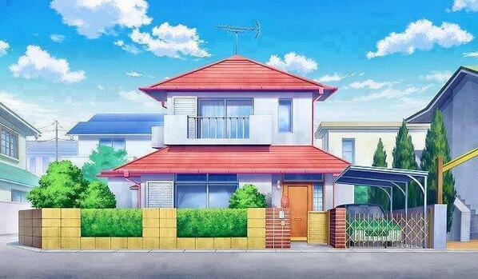
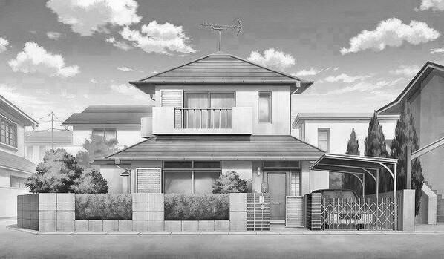

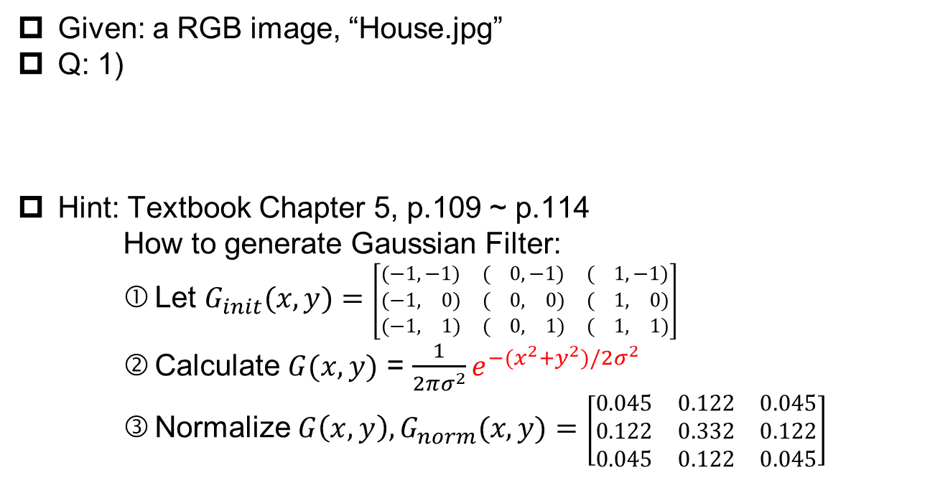
3.1 Gaussian Blur (5%)
(出題：Lydia)
Given: a RGB image, “House.jpg”
Q: 1)
Hint: Textbook Chapter 5, p.109 ~ p.114
How to generate Gaussian Filter:
Let $G_{init}(x, y)=$ $\left[\begin{matrix}(−1,−1) & ( 0,−1) & ( 1,−1) \\ (−1, 0) & ( 0, 0) & ( 1, 0) \\ (−1, 1) & ( 0, 1) & ( 1, 1)\end{matrix}\right]$
Calculate $G(x, y)$ = $\frac{1}{2πσ^{2}}e^{−(x^{2}+y^{2})/2σ^{2}}$
Normalize $G\left(x, y\right),G_{norm}(x, y)=$ $\left[\begin{matrix}0.045 & 0.122 & 0.045 \\ 0.122 & 0.332 & 0.122 \\ 0.045 & 0.122 & 0.045\end{matrix}\right]$
Gaussian Blur: Convert the RGB image into a grayscale image, then smooth it by your own 3x3 Gaussian smoothing filter (Can not use OpenCV Function). Please show the result.
House.jpg
Grayscale
Gaussian Blur

Slide 16
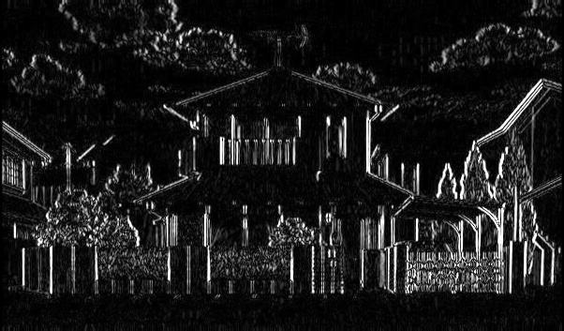
3.2 Sobel X (5%)
(出題：Lydia)
Given: the result of 3.1) Gaussian Blur
Q: 2)
Hint: Textbook Chapter 6, p.148 ~ 149
Sobel X: Use Sobel edge detection to detect vertical edge by your own 3x3 Sobel X operator (Can not use OpenCV Function). Please show the result.
-1 | 0 | 1
-2 | 0 | 2
-1 | 0 | 1
Sobel X Filter
Gaussian Blur
Sobel X

Slide 17
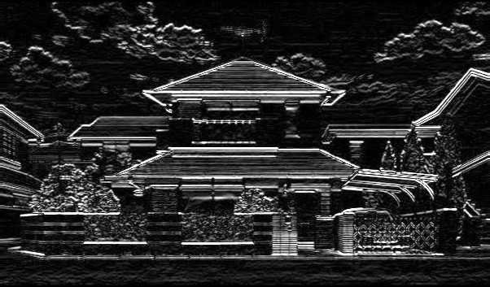
3.3 Sobel Y (5%)
(出題：Lydia)
Given: the result of 3.1) Gaussian Blur
Q: 3)
Hint: Textbook Chapter 6, p.148 ~ 149
Sobel Y: Use Sobel edge detection to detect horizontal edge by your own 3x3 Sobel Y operator (Can not use OpenCV Function). Please show the result.
1 | 2 | 1
0 | 0 | 0
-1 | -2 | -1
Sobel Y Filter
Gaussian Blur
Sobel Y

Slide 18
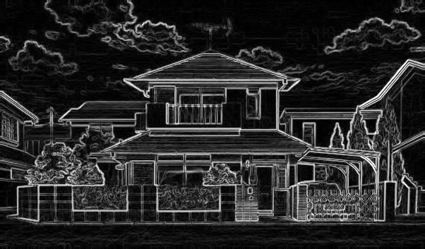
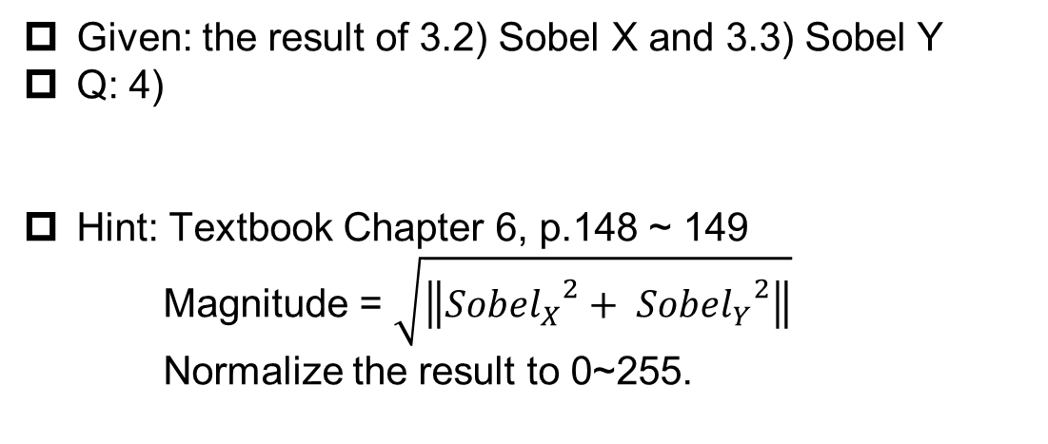
3.4 Magnitude (5%)
(出題：Lydia)
Given: the result of 3.2) Sobel X and 3.3) Sobel Y
Q: 4)
Hint: Textbook Chapter 6, p.148 ~ 149
Magnitude = $\sqrt{\left\|{{Sobel}_{X}}^{2}+ {{Sobel}_{Y}}^{2}\right\|}$
Normalize the result to 0~255.
Magnitude: Use the results of 3.2) Sobel X and 3.3) Sobel Y to calculate the magnitude. Please show the result.
Sobel X
Magnitude
Sobel Y

Slide 19
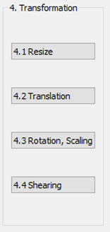
4. Transforms (20%)
(出題: Ray)
4.1 Resize (5%)
4.2 Translation(5%)
4.3 Rotation, Scaling (5%)
4.4 Shearing (5%)

Slide 20
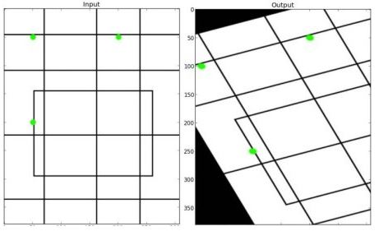
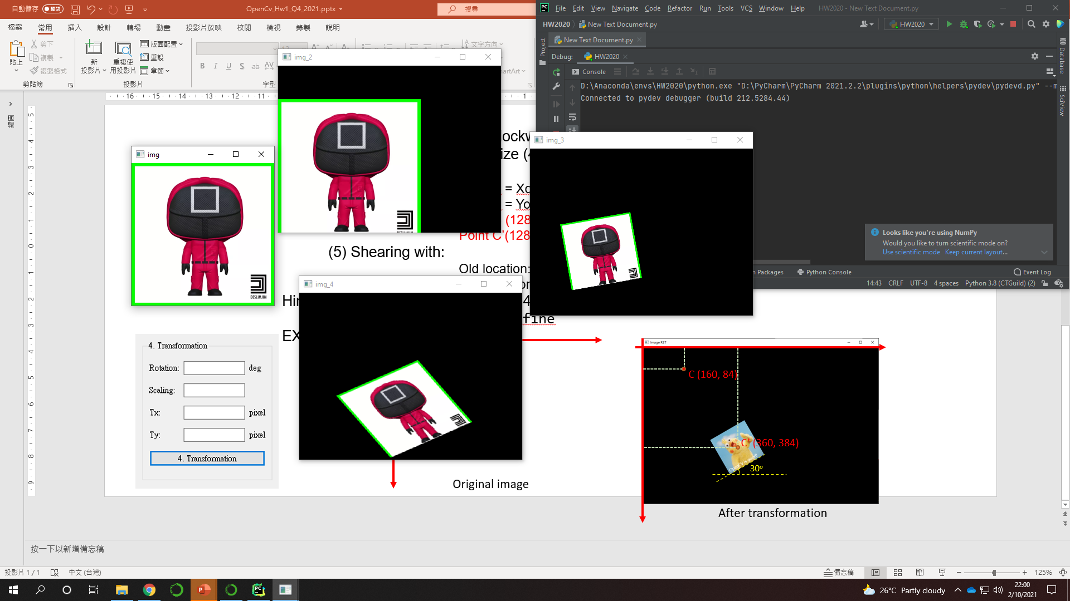
4. Transforms: Resize, Translation, Rotation, Scaling, Shearing(20%)
Given: “SQUARE-01.png”
Q:Please resize, translate , rotate, scale and shearing the Red SQUARE (as image below) with following parameters (should be entered in the GUI)
1) Resize = (256,256)
2) Translation with:
Xnew = Xold + 0 pixels = 128 + 0 = 128
Ynew = Yold + 60 pixels = 128 + 60 = 188
Point C (128, 128) is center of resized image Point C’(128, 188) is new center of image
3) Angle = 10º (counter-clockwise)
Scale = 0.5 , window size (400,300)
4) Shearing with:
Old location: ([[50,50],[200,50],[50,200]])
New location: ([[10,100],[200,50],[100,250]])
Hint: Textbook Chapter 12, (p.407 ~ 412) python: cv.warpAffine
EX:
(出題: Ray)
(0,0)
C (128, 128)
C’ (128, 188)
10º
Resized image
After translate
After rotate and scale
After Shearing (Result)
Notes:
4) https://blog.csdn.net/qq_39507748/article/details/104448700

Slide 21
5. Training Cifar10 Classifier Using VGG16 (20%)
(出題: Tommy)
5.1 Show Training Images (4%)
5.2 Show Hyperparameters (4%)
5.3 Show Model Structure (4%)
5.4 Show Accuracy and Loss (4%)
5.5 Test (4%)

Slide 22
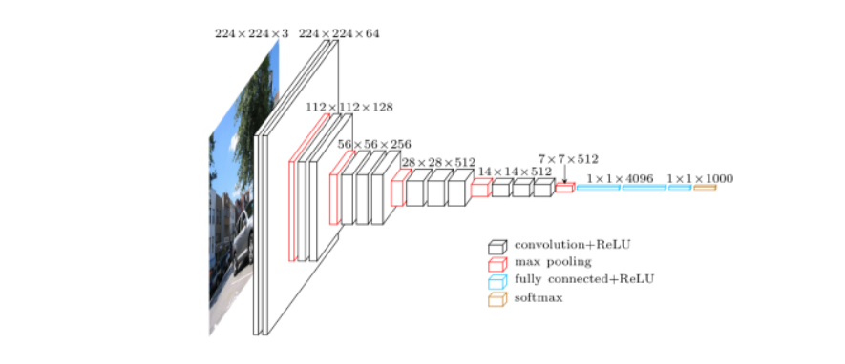
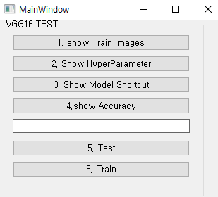
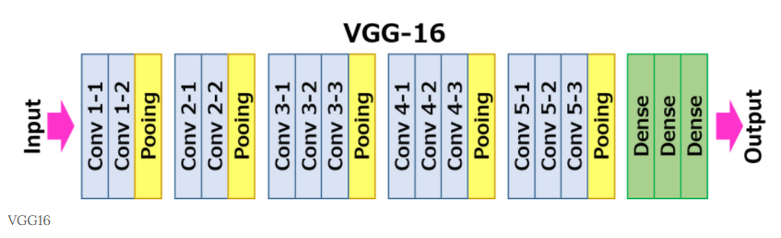
5.0 Training Cifar10 Classifier Using VGG16 (出題：Tommy)
Learn how to construct VGG16 and train it on Cifar10.
Environment Requirement
Python
Tensorflow / PyTorch (Can choose the one)
opencv-contrib-python
Matplotlib
Reference
https://paperswithcode.com/method/vgg (VGG16, Paper and Source Code)
https://www.cs.toronto.edu/~kriz/cifar.html (Cifar10 Dataset)
GUI example
VGG16 framework

Slide 23
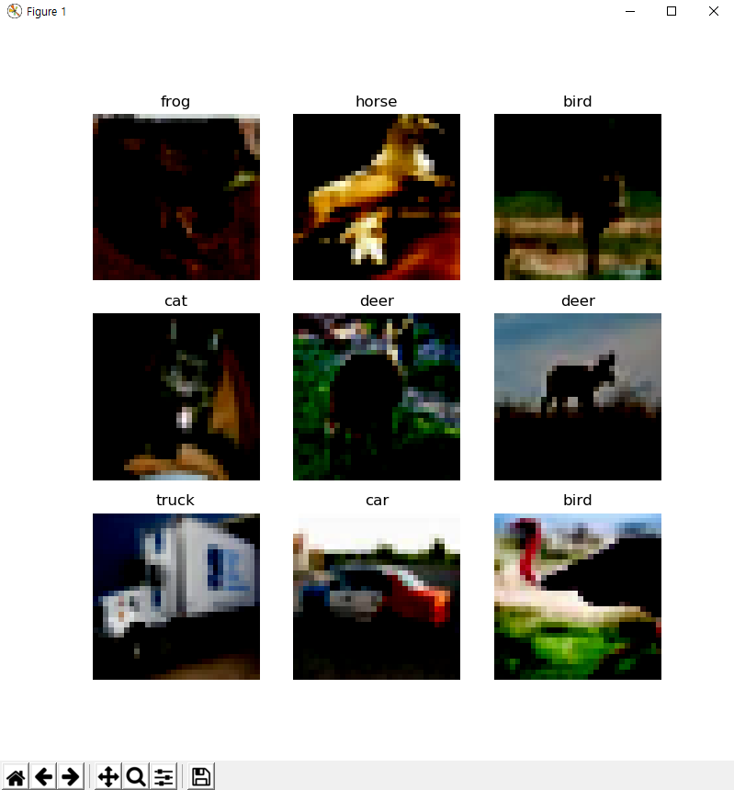
5.1 Load Cifar10 training dataset, and then show 9 Images(Pop-up) and Labels respectively (4%)
Class
Label
0 airplane
1 automobile
2 bird
3 cat
4 deer
5 dog
6 frog
7 horse
8 ship
9 truck
Image
10 Class of CIFAR 10 Dataset
◆ Hint
Use Matplotlib 4 function
figure()
title()
Axis()
imshow()
Can refer by tutorial at the Matplotlib library official web-site
https://matplotlib.org/stable/tutorials/index.html
Notes:
https://github.com/snatch59/load-cifar-10

Slide 24
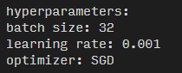
5.2 Print out training hyperparameters on the terminal
(batch size, learning rate, optimizer). (4%)
◆ Hint
Use the python print function
Print(‘Batch Size {} ’, format(Batchsize variable name))

Slide 25
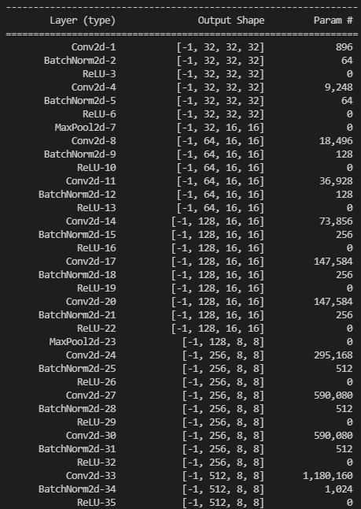
5.3 Construct and show your model structure by print out on the terminal (You can use available architecture provided by ML framework to build your model) (4%)
◆ Hint
Pytorch API
Use the two option
Summary function
from torchsummary import summary
-> import the package
summary(Model name, (Input Channel, Input Width, Input Height))
-> run the function and print on the terminal
Print function
From torchvision import models
-> import the package
Model = VGG16()
-> Make the mode data
Print(Model)
Can refer this web-site
https://pypi.org/project/pytorch-model-summary/
Layers List of
Model
After processing
each layer
Change of input
data type
Number of
trainable
parameters

Slide 26
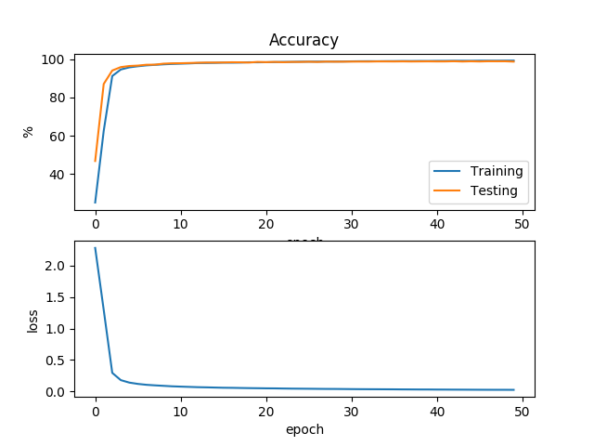
5.4 Training your model at least 20 epochs by your own computer, then save your model and take a screenshot of your training loss and accuracy. No saved images no points (4%)
◆ Hint
There are two option.
Just use the normal method(Above image used this way)
https://www.pyimagesearch.com/2021/07/19/pytorch-training-your-first-convolutional-neural-network-cnn/
2) Use tensorboard in Tensorflow API or tensorboard in pytorch
https://pytorch.org/tutorials/intermediate/tensorboard_tutorial.html
(record accuracy/loss per epoch)

Slide 27
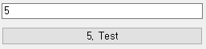
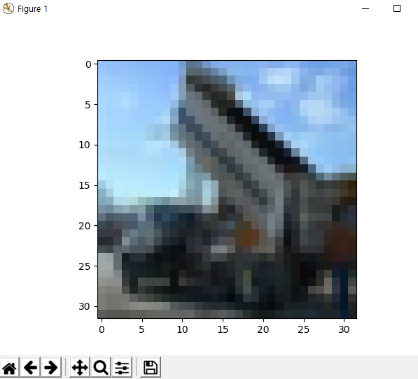
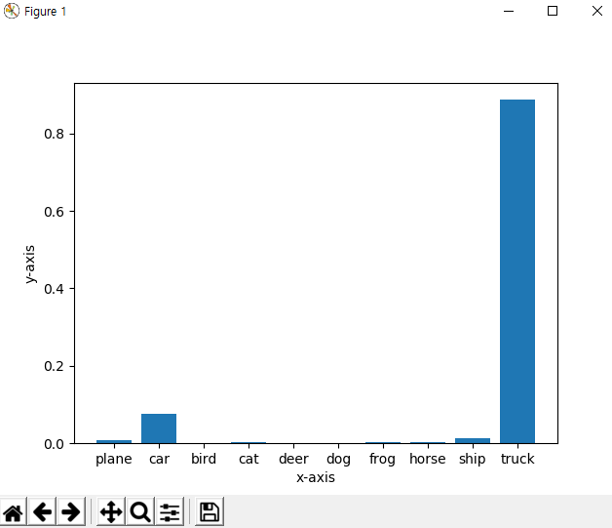
5.5 Load your model trained at 5.4, let us choose one image from test images, inference the image, show the result image and class(use the pop-up) (4%)
1. Choose the any data
2. Run Inference
3. Show the result
◆ Hint
Can refer two web-site
https://towardsdatascience.com/understanding-pytorch-with-an-example-a-step-by-step-tutorial-81fc5f8c4e8e#5017
https://pytorch.org/tutorials/

